Slide 1


HACKATHON - 2024

Slide 2
Objective #1: Experiment , Explore and Expand
Call one LLM, call multiple LLMs, securely and insecurely.
Experimenting with different parameters to observe variations in outputs.
Call an image LLM and displaying the generated image.
Having the LLM give out a nonsensical / erroneous response
The most creative image relevant to the Hackathon theme.
Most creative prompt to LLM and highlighting the response.
Engineers are demonstrating the above activities to the team
SMEs, Product Managers and Team Leaders
What business outcomes could this technology drive, where do you see the risks.
What learnings in this building block exercise do you see.
Creating a list of opportunities and risks. The list will be broad since the learnings here are broad.
Please discuss with the judges each of the sections. Also discuss learnings and business outcomes and your list of potential opportunities

Slide 3




Objective #2 : Implement Use Case
Understand your use case
Develop your use case
What did you learn?
How could you extend this use case
Engineers are demonstrating the above to the team
SMEs, Product Managers and Team Leaders
Does the use case here allow you to filter the use cases you came up with.
Does the use case here bring clarity to the capabilities
Please discuss with the judge the tasks and the outcomes of the use case.
Also discuss the use cases, is this use case assigned helping come up with concrete elements for a few of the use cases.
Which use case would you collectively like to develop and forge ahead on?

Slide 4






Objective #3 : Final Presentation (Invest).
What did you learn?
Make sure you take a team selfie
Take screenshots of interesting responses
Come up with a concrete use case that Gen AI can solve for you, your team or the company
Create a business case for your use case (investment + outcome).
Did you have fun?
Please answer the questions posed above.
A few indicator slides are added below to help you start your own presentation
Which use case would you collectively like to develop and forge ahead on?

Slide 6
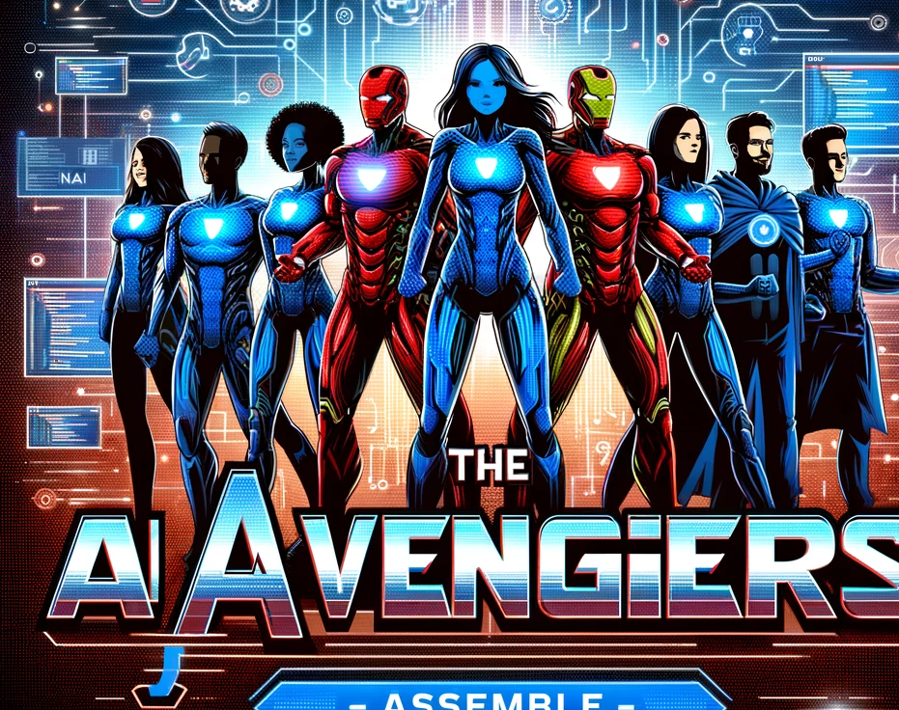
The AI Avengers - Assemble

Slide 7

Our Team & Our Use Case
Role | Full Name | Call Sign
Team Leader | Taylor Miller | Eagle
Product Owner | Skyler Smith | Dragon
Engineer | Jordan Smith | Viper
Engineer | Skyler Brown | Viper
Engineer | Sam Brown | Lion
SME | Casey Jones | Viper
WhatsApp – Application.
We built XXX

Slide 8

The Hackathon

Slide 9
What we did and how it has informed the Use Case we think merits development.
Investment Needed
Outcomes Supported

Slide 10

Thank you
www.addvaluemachine.com
10

Slide 11
Use Cases
(Assignments might will Change)
Use Case 1 : Data Analysis
Use Case 2 : AI Powered Chat
Use Case 3 : Email Automation
Use Case 4 : WhatsApp
Use Case 5 : CodeAssistance
Use Case 6 : Procurement Status

Slide 12
Hackathon Schedule
Time | Event
8:00 AM | Maisa Welcomes Everyone (Invite Sean) Welcome Message from Sean Langton + Dimitry Maisa introduces Ravi Singh (AVM)
8:20 AM | Hackathon Starts!
9:30 AM | Objective 1 should be wrapping.
10:30 AM | Objective 2 should be started.
11:30 AM | Checking in with Judges. Objective 2 should be wrapping. Objective 3 should be finalizing
12:30 PM | Lunch Break / Prayer. Objective 2 Code Released
2:00 PM | Hackathon Resumes : Finalize presentations. Final 30 mins to get Judges to come to you for your scores
2:45 PM | Judges + Advisors score and select Final 3
3:00 PM | Final 3 presentations to Executive Judges
4:00 PM | Hackathon Ends!

Slide 13
Objective #1: Scoring / Judging.
Total 35 points.
30 points tasks.
5 points judge + advisor discretion.
Call one LLM, call multiple LLMs, securely and insecurely. (5 pts)
Experimenting with different parameters to observe variations in outputs. (5 pts)
Call an image LLM and displaying the generated image (5 pts)
Having the LLM give out a nonsensical / erroneous response. (5 pst)
Creating the most creative image relevant to the Hackathon theme. (5 pts)
Crafting the most creative prompt to LLM and highlighting the response. (5 pts)

Slide 14
Objective #2 : Use Case Development
Total 65 points.
10 points understanding the use case.
30 points completeness of the use case.
If source code is used by the team 10 points max
10 points identifying what the team learned
10 points on ideas of extension.
5 points Judges + Advisors discretion.
Understand your use case
Develop your use case
What did you learn?
How could you extend this use case

